Slide 1
Current status of WP2
Hanne Marbo, Natalie Quiniou, Olga Moreira, Manuela Vaz-Velho, Giuseppe Bee, Peadar Lawlor,
20.02.2020 – IPEMA - Alghero

Slide 2
Objectives and Deliverables of WG2
Objectives
Development of nutritional concepts for entire males (EM) and immunocastrates (IC),
  To meet nutritional requirements of EM and IC innovative nutritional concepts are needed
  To reduce boar taint
  To compensate alterations of intramuscular fat content and fatty acid composition
Deliverables
    Knowledge gaps for further research activities
    List of feed ingredients with boar taint reducing capacities
    Nutrient recommendation for EM and IC

Slide 3
Delivered Deliverables - Knowledge Gaps and List of Feed Ingredients
A list of knowledge gaps for research activities (meeting in Prag)
        Optimize feeding management
        Formulation of diets not only on NE and EAA contents but also on fermentescible fiber to make the connection with the nutritional characteristics of some feedstuffs that reduce efficiently the boar taint risk. The NE and EAA contents of these feedstuffs must be evaluated
        What other feed additives might be useful in modulating the microbiota and thereby skatole?
        Are there differences between breeds in level of boar taint and the effects of factors that affects boar taint?
        Impact of genetic selection against boar taint
        Do entire males benefit from a more protein/amino acid and energy dense diet?
        Identify the optimum concentrations of bioactive compounds in feed. Identify interactions of bioactive compounds and feed ingredients. Perform in vivo studies (help to confirm mechanisms in real life situation) based on results of in vitro studies (help to explain mechanisms). Identify more bioactive compounds or feed additives might be useful in modulating boar taint and/or the microbiota?
    Does enterohepatic circulation of androstenone exist?
    Is androstenone absorbed?
    Which bacteria are responsible for skatole production in hindgut and why does castration reduce skatole in backfat?
Publish a list of feed ingredients with boar taint reducing capacities (meeting in Belgrade)
    https://zenodo.org/record/1460483

Slide 4
Missing Deliverable - Updated Nutrient Recommendation for EM and IC
What are the current nutrient requirements – NRC, 2012

Slide 5
Protein and lipid deposition – NRC - 2012

Slide 6
SID - Lysine recommendations – NRC - 2012

Slide 7
Experimental setup
Agroscope 2019
Standard diets (C) Low protein diets (LP)
Gilts Entire Gilts Entire
Barrows males Barrows males
g lysine/MJ NE
Grower: 1.00 1.05 0.78 0.83
Finisher I: 0.79 0.82 0.63 0.66
Finisher II: 0.71 0.74 0.58 0.60
g lysine/MJ ME
Grower: 0.75 0.81 0.60 0.63
0.72/0.66 0.76
Finisher I: 0.58 0.61 0.48 0.51
0.54/0.48 0.60
Finisher II: 0.54 0.56 0.44 0.46
0.42/0.37 0.49

Slide 8
Newer data of protein and lipid deposition
Agroscope 2019

Slide 9
Newer data of protein and lipid deposition
Agroscope 2019

Slide 10
Newer data of protein and lipid deposition
Agroscope 2019

Slide 11
Lysin deposition rate
Agroscope 2019

Slide 12
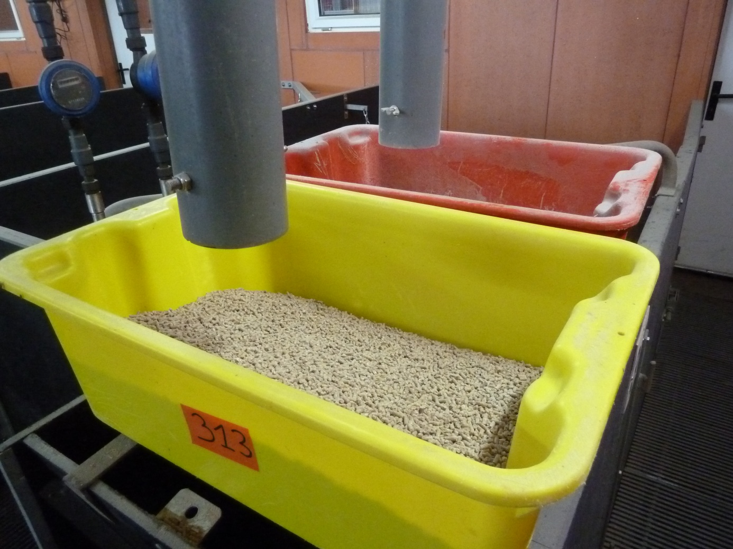
Amino acid concentration
Be careful to the lysine level per unit of net energy
Growth performance of EM
under two different 2-phase (2P) strategies
Digestible lysine, g/MJ NE
2P-EM = based on requirement of entire males
2P-CM = based on requirement of castrated males
requirement of entire males
requirement of castrated males
+0.1 g/MJ
2P-CM
0.84 / 0.71 g/MJ NE
2P-EM
0.94 / 0.81 g/MJ NE
Quiniou et al. (2015)

Slide 13
Amino acid concentration in diets for EM
Be careful to the lysine level per unit of net energy
Growth performance of EM
under two different 2-phase (2P) strategies
Average growth performance
Males
fed the 2P-CM diets
Males
fed the 2P-EM diets
ADG, g/d |  | 886 |  | 898
FCR |  | 2.39 |  | 2.28
Carcass leanness |  | 60.7 |  | 62.2
A diet optimised for CM is cheaper than the diet optimised for EM
but it does not allow to take a full advantage of the growth potential of the EM
because AA supplies are limiting for muscle deposition
Quiniou et al. (2015)
(LWxLD) x (LWxPP)

Slide 14
Amino acid balance
Be careful to the ratio between essential AA
Average growth performance
Carcass leanness |  | 62.2 |  | 60.9
ideal protein**
unbalanced eAA*
**minimum ratio with dig. LYS, % | MET | M+C | THR | TRP | VAL | ILE | HIS | LEU
 | 30 | 60 | 65 | 19 | 70 | 53 | 32 | 100
**observed ratio dig. LYS, % | MET | M+C | THR | TRP | VAL | ILE | HIS | LEU
 | <30 | <60 | <65 | 19 | 70 | 53 | 32 | 100
Concentration in all other essential amino acids must be increased to meet the requirement of entire male (ideal protein profil).
Otherwise, the high potential of entire male for muscle growth is impaired.
Quiniou et al. (2015) and unpuplished

Slide 15



Impact of feeding level in EM
Carcass leanness
Growth rate
Hunger, activity, aggressiveness
Energy fuel for activity
= deterioration of FCR
more intense
feed restriction
moderate feed restriction
Feed conversion ratio
ad libitum

Slide 16

Recommendations for male pigs in DK
Trial with extra energy and protein for increased growth
Trials with fibres to reduce boar taint based on skatole
Trials with active coal

Slide 17

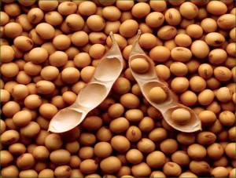
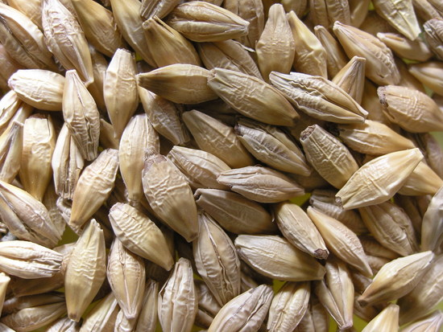
Maximum growth + reduced odor
Increase the entire males growth - younger at slaughter
  Increase protein and amino acids in feed with +15%
  Increase energy (FUgp) with +8%
Results
  Male pigs daily gain was increased by 65 g (***)
  Feed conversion and lean meat percentage was not affected
Results for boar taint
  Skatol equal
  Lover human nose character

Slide 18
Male pigs diet composition
 | Control | + protein & energy | Diff%
 | Analyseret | Analyseret
FUgp/kg (digest. energy) | 105,6 | 112,7 | 6
Raw protein % | 15,9 | 18,1 | 12
Rå fat, % | 3,6 | 4,9 | 27
Ash, % | 4,6 | 5,1 | 10
Calcium | 7,12 | 7,87 | 10
Posphor | 4,70 | 4,95 | 5
Lysine | 10,2 | 11,69 | 13
Methionine | 3,01 | 3,55 | 15
Meth + cys | 5,95 | 6,69 | 11
Treonine | 6,78 | 8,1 | 16
Cystine | 2,94 | 3,14 | 6
Tryptofane | 2,16 | 2,52 | 14

Slide 19
Male pigs
 | Kontrol | +protein & energy | Diff. | p-value
No of pigs | 684 | 703 |  | -
Pens | 46 | 47 |  | -
Weight at insertion, kg | 29.0 | 29.2 | +0.2 | -
Carcass weight, kg | 82.0 | 84.1 | +2.1 | <0.0001
Lean meat % | 60.7 | 60.6 | -0.1 | 0,5248
Daily weight gain, g/day | 1084 | 1147 | 62.5 | <0.0001
Age at slaughter | 73.8 | 69.2 | -4.6 | -
FUgp/day | 2.54 | 2.67 | 0.13 | <0.0001
FUgp/kg gain | 2.34 | 2.33 | -0.01 | 0.1773
PV/pen/year, EUR | 117 | 129 | -12 | 0.0001
Indeks PV | 100 | 110 | 10
Diet price index | 100 | 105 | 5
What can we pay | 100 | 105 | 5
No effect on diarrhoea or mortality

Slide 20
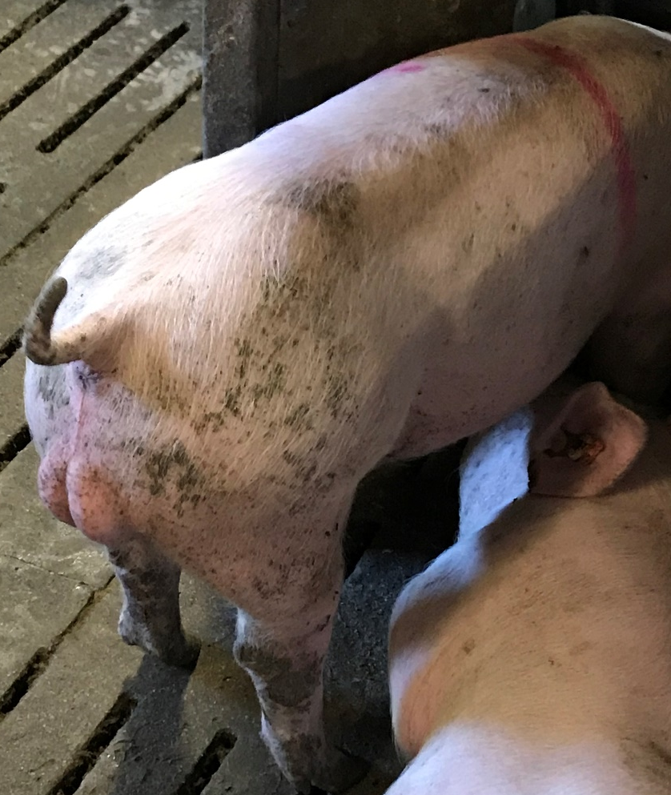
Reccomendations for male pig producers
Increase energy content by 8% and protein by 15%
Ad fibres Chicory, sugar beat pulp to reduce skatole in fat
Feed pure grain the last 2-3 days before slaughter to reduce skatole in fat

Slide 21






PIGS+CARE Project results
PIGS+CARE - Optimization of heavier pig carcasses production by natural and zealous means and without castration
POCI-01-0247-FEDER-017626
Co-financed by

Slide 22





PIGS+CARE Project
Project PIGS+CARE was created by a consortium of three private companies, representative of the whole pig´s production chain, including a feed production company that coordinates the project, and two R&DT public institutions
The main objective was the optimization of heavier pig carcasses production by natural and zealous means and without castration, aiming for new meat products without residues and high added value.
Its main activities were the introduction of welfare and hygiene practices in housing and transportation (+Care) and the introduction of functional foods in finishing diets in order to guarantee a substantial reduction of skatole and androstenone in fresh and processed pork meat. A trained sensory panel was formed to detect the intensity of boar taint in fresh and processed pork meat.

Slide 23
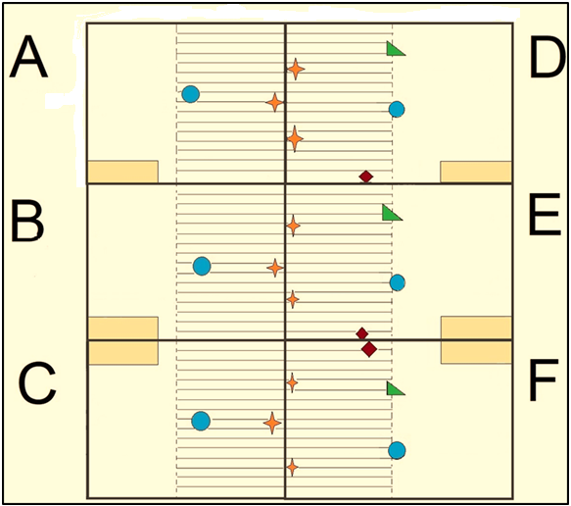
PIGS+CARE Project
Genetics: F1 (Landrace x Large White) X Pietrain
60 animals (10 x 6 groups): 3 feeding formulas x 2 housing conditions (Normal - A,B,C vs. +CARE – D, E, F )
Feeding and housing experiments lasted 7 weeks; animals were slaughtered at 8 months of age
Diet composition
Code | Description
D1 | Control
D2 | Sugar beetroot pulp
D3 | 2.4% Inulin + Sugar beetroot pulp

Slide 24
PIGS+CARE Project
No significant differences (ANOVA 3x2) for average daily intake, average daily gain, conversion index or carcass yield
 | A | B | C | D | E | F
Daily intake (kg/day) | 2.92 | 2.91 | 2.68 | 2.84 | 3.16 | 2.90
Daily gain (kg/day) | 0.92 | 0.96 | 0.87 | 0.90 | 1.04 | 1.01
Conversion rate | 3.18 | 3.04 | 3.10 | 3.15 | 3.03 | 2.88
Welfare Quality Indicators (Welfare Quality®): Average incidence of injuries was lower in +CARE treatment
Animals housed in lower density (+CARE) had lower concentration of plasma cortisol, being significant (p<0.05) at the end of the experiments (a week prior to slaughter)

Slide 25
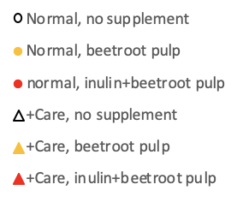
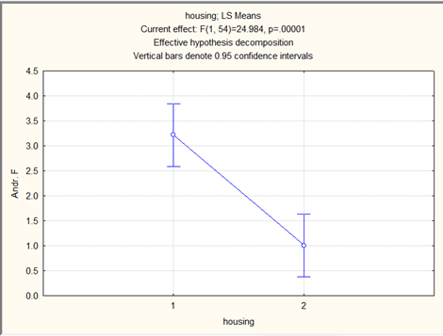
PIGS+CARE Project
Skatole and androstenone concentrations in plasma and liquid fat from backfat and belly fat
Backfat
Belly fat
Backfat:
Lower SKA in supplemented feed (p<0.001)
Lower AND in +CARE (p=0.050)
Belly fat:
Lower SKA in supplemented feed (p<0.001)
Lower AND in +CARE (p=0.046)
Analysis in plasma: lower AND in +CARE (p<0.001)
(Ghent University LC MS)

Slide 26

PIGS+CARE Project
Main results and conclusions
The addition of functional ingredients led to a significant decrease in skatole levels in the meat
+CARE treatments lead to a significant decrease in androstenone levels and also stress levels (through cortisol measurement);
Entire male’s meat products (cooked ham, bacon) were tested and approved by a consumer panel;
It is being prepared a quality seal (+CARE) that highlights practices associated with reducing male odour in meat that in parallel provide a higher degree of animal welfare and reduced pig farming environmental impact.

Slide 27

Thank you for your attention
Agroscope gutes Essen, gesunde Umwelt
www.agroscope.admin.ch

